Slide 1


Completing a DTS Voucher
CNRFC N14 Travel Department
Last Updated
07AUG2025

Slide 2
REQUIRED DOCUMENTS IN VOUCHER
Original orders
All ORDMODS (if you received any)
Signature page of orders (wet signed or downloaded from NSIPS)
Itemized lodging receipt (if lodging was used)
CWT SATO invoice (if you flew)
Completed CTW (Constructed Travel Worksheet) if you used POV
Rental Car Receipt w/ gas receipts (if you had rental car)

Slide 3
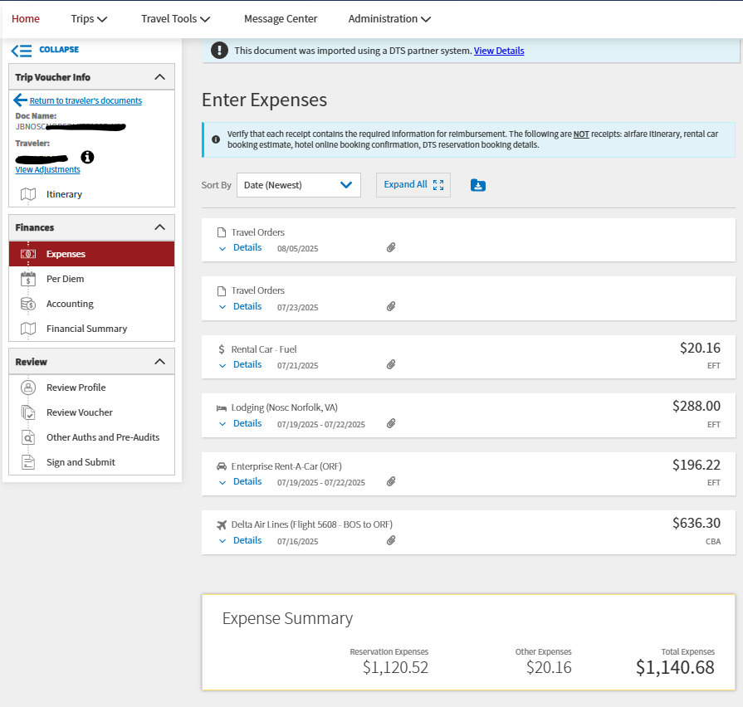


EXAMPLE OF PERFECT VOUCHER
Orders and Signature Page
Gas for Rental Car
Lodging
Rental Car
Flight itinerary

Slide 4
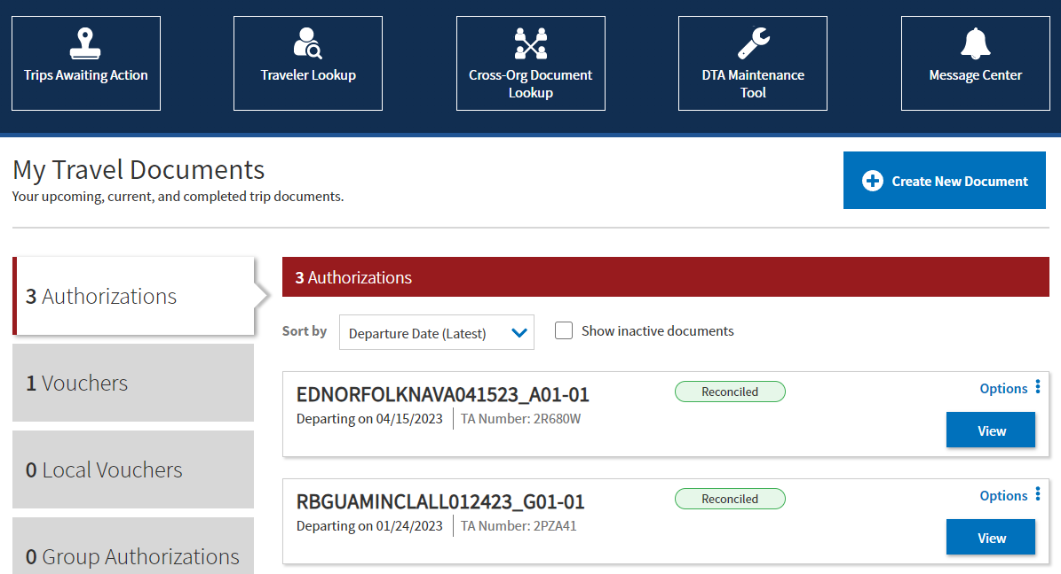
Step 1: Select “Create New Document”
HOW TO CREATE THE VOUCHER

Slide 5
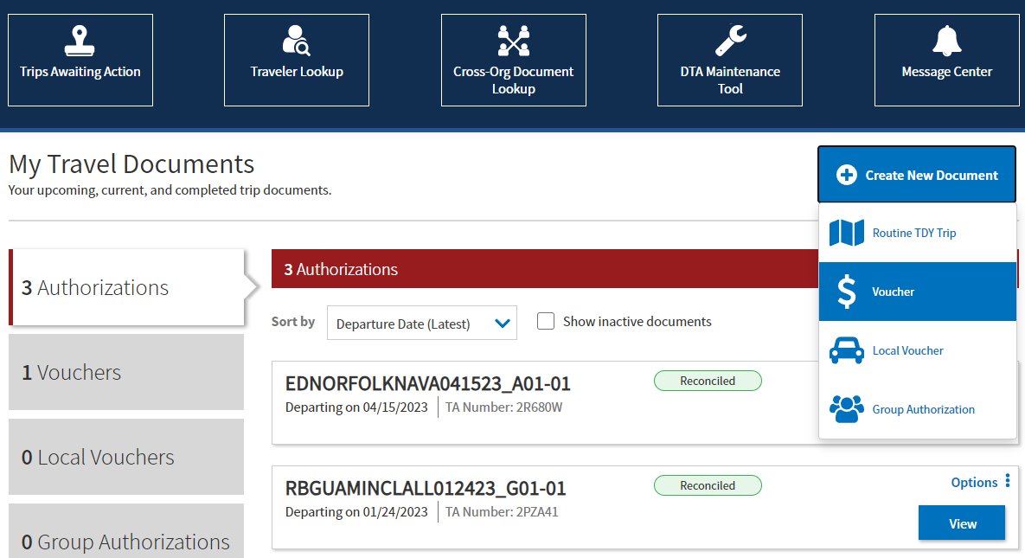
Step 2: Select “Voucher”
Creating Voucher

Slide 6
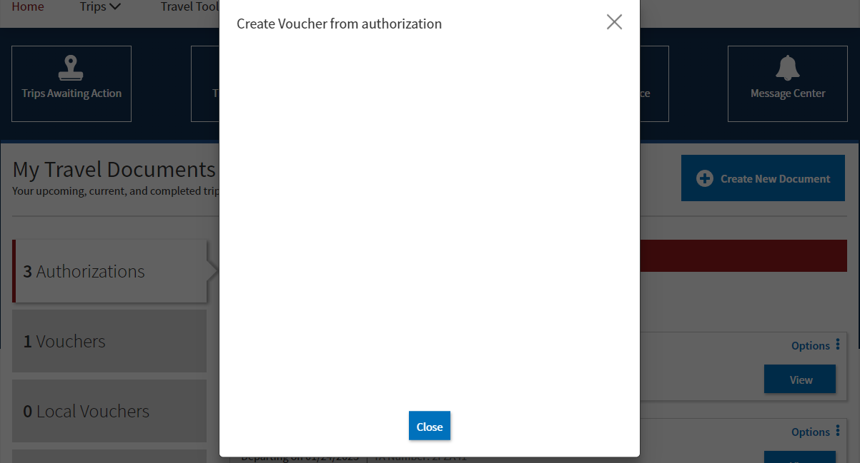
Step 3: Select “Create Voucher”
Creating Voucher
Select the authorization that appears here to create a voucher for it
*If nothing populates in this drop down, please email the N14 Travel distro*

Slide 7
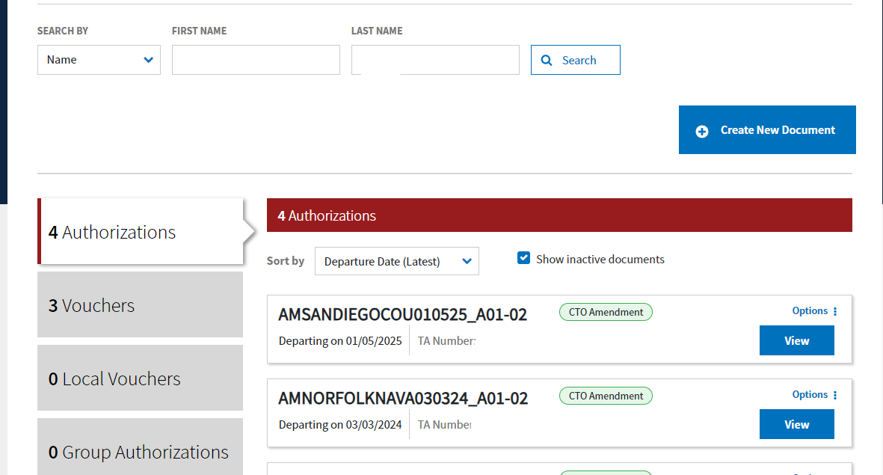
Step 4: “Click Vouchers” tab to locate an already created voucher to continue to edit
Creating Voucher
If you cannot find what you are looking for make sure this button is clicked.

Slide 8
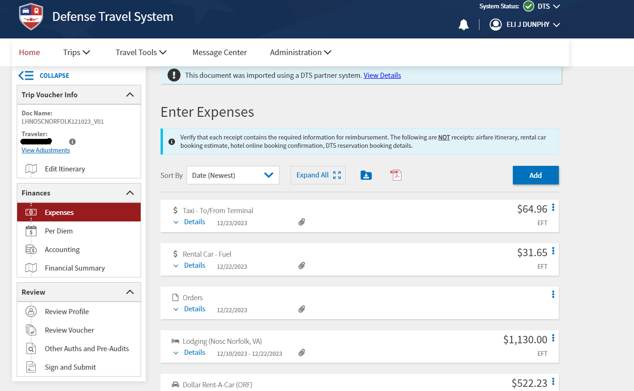
How to Upload in Voucher
All documents will be attached in the “EXPENSES” tab.
Click on the “EXPENSES” tab (on the left side.)
Click here to create a new expense item.
Expenses are added in this tab

Slide 9
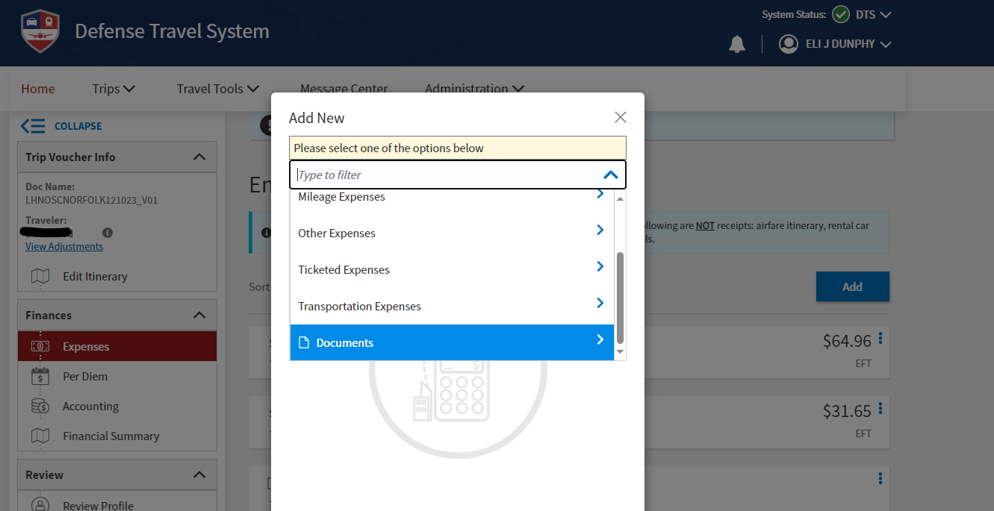
Uploading Orders/ORDMODS and Signature Page to DTS
Select from the drop down the type of expense you need to add.
*If you cannot find the exact type you need, you can just select “documents” and attach your receipt to it.*

Slide 10
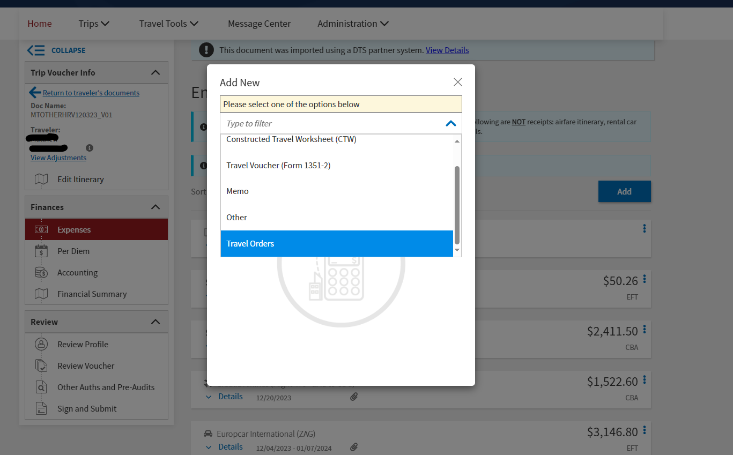
For Example: When adding your Orders, you would select “Documents,” then select “Travel orders.”
*You can also type into the search exactly what you are looking for.*

Slide 11
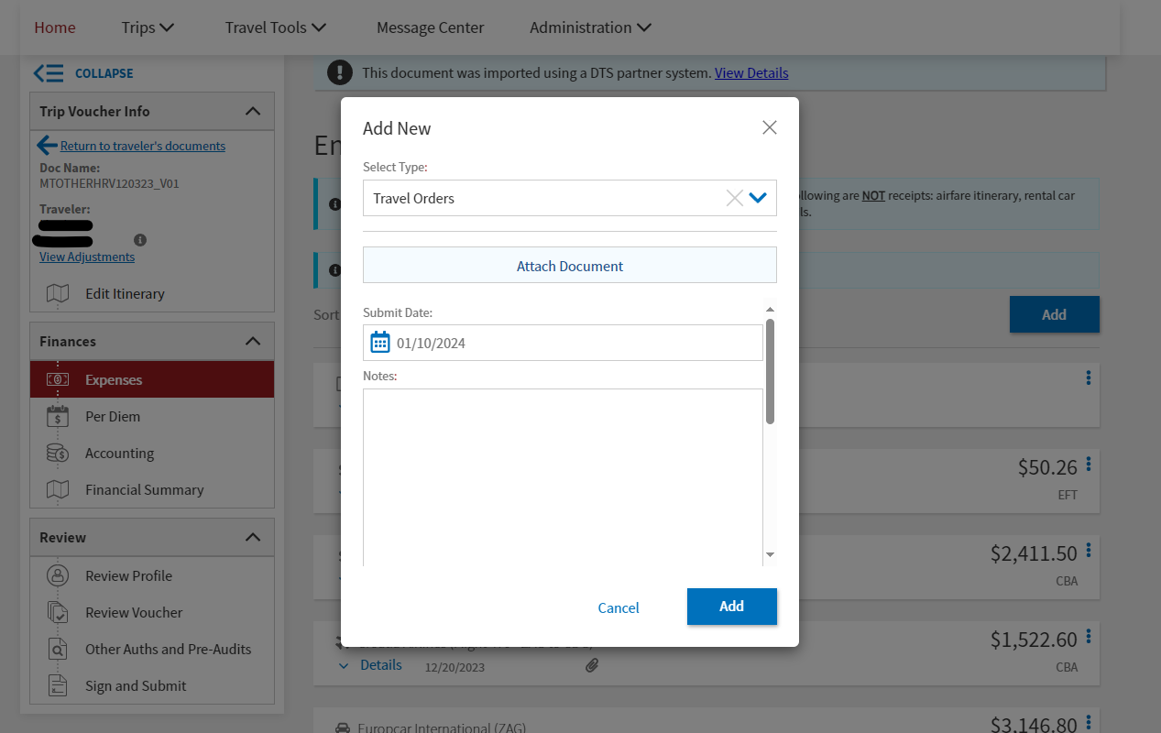
Once you’ve selected what type of document you are adding, it will prompt you to attach the file/receipt.
Attach all orders, ORDMODS, and signature page here

Slide 12
If you have anything you would like us to know about the expense type it in the notes!

Slide 13
How to Find your Orders/ORDMODS and
Signature Page

Slide 14
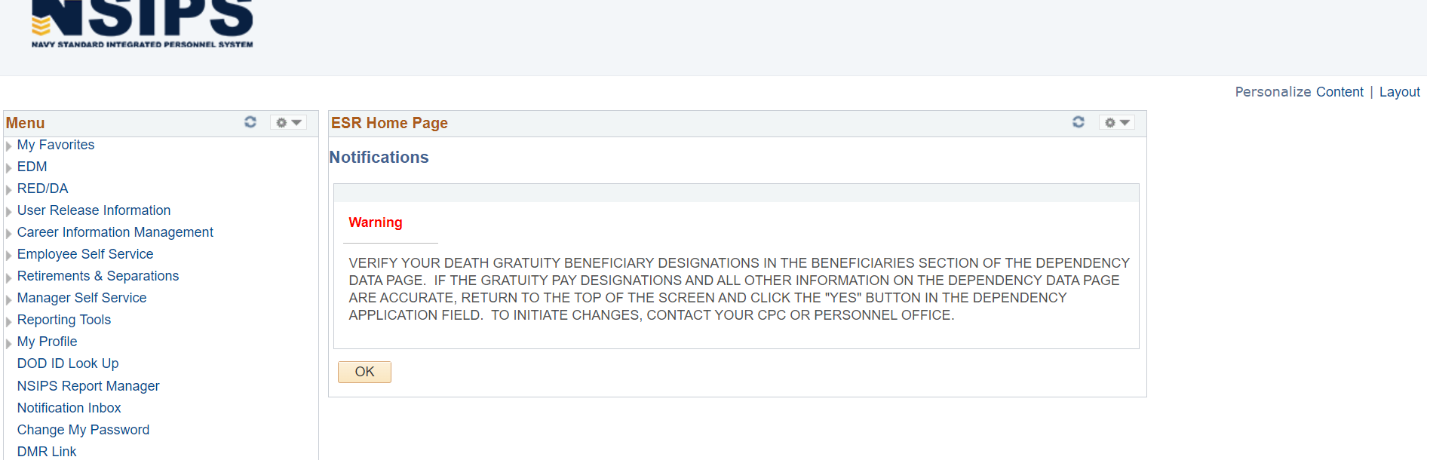
How to Find Orders/ORDMODS and Signature Page
Log into NSIPS
Click “Employee Self Service” from the menu

Slide 15
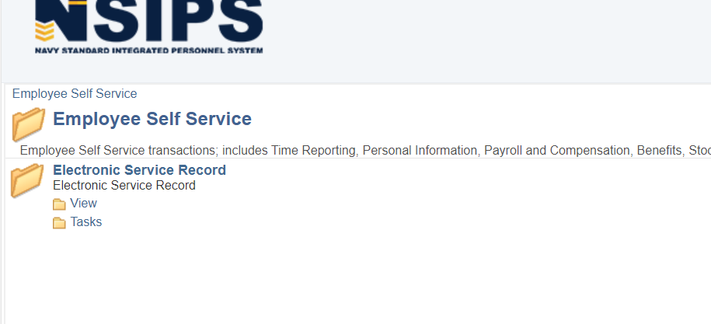
How to Find Orders/ORDMODS and Signature Page
Click “View”

Slide 16
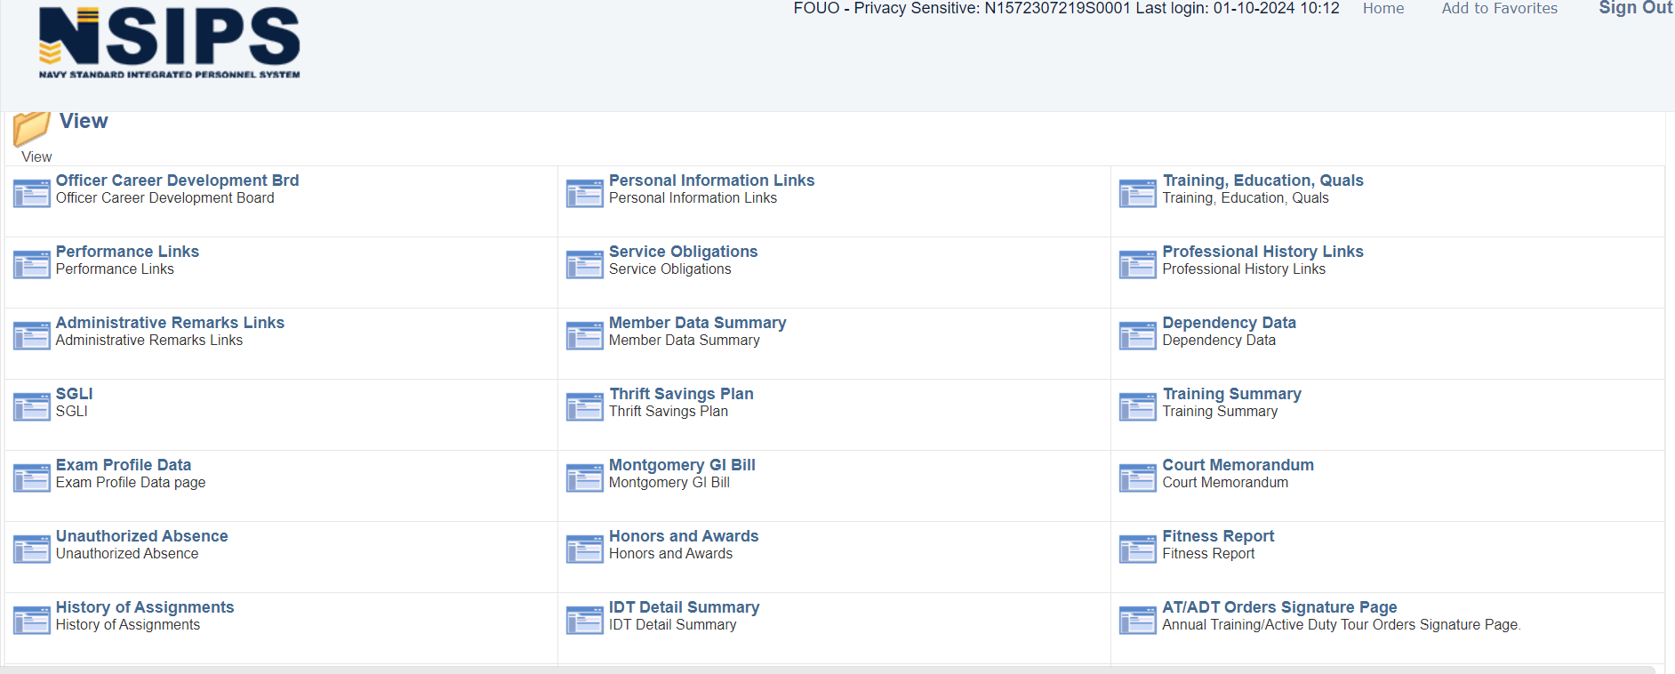
How to Find Orders/ORDMODS and Signature Page
Click “AT/ADT Orders Signature Page”

Slide 17
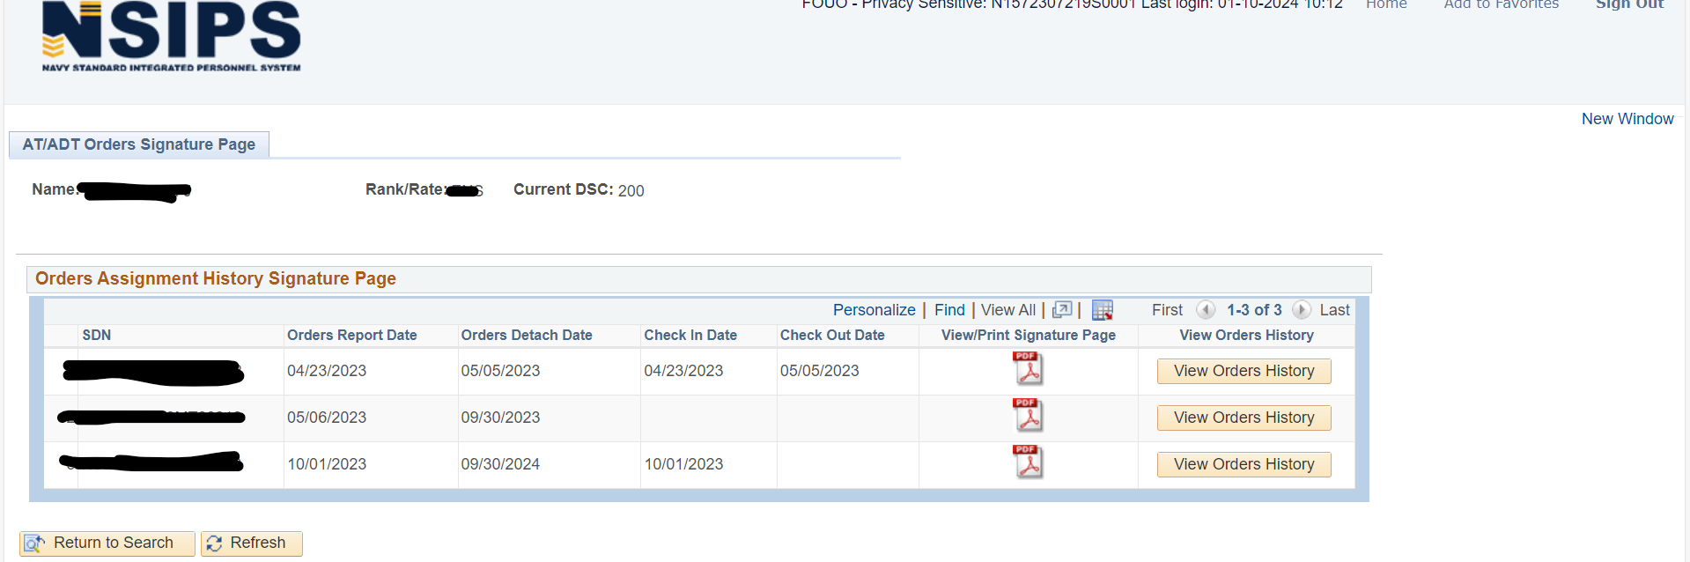
How to Find Orders/ORDMODS and Signature Page
Retrieve orders/ORDMODS and signature page
This will have your full orders and ORDMODS.
This will have your signature page.
*If your signature page is completely blank (NOT SIGNED) and you have been off orders more than 5 days please contact the OIC or POC on your orders to request proper E-mustering*

Slide 18
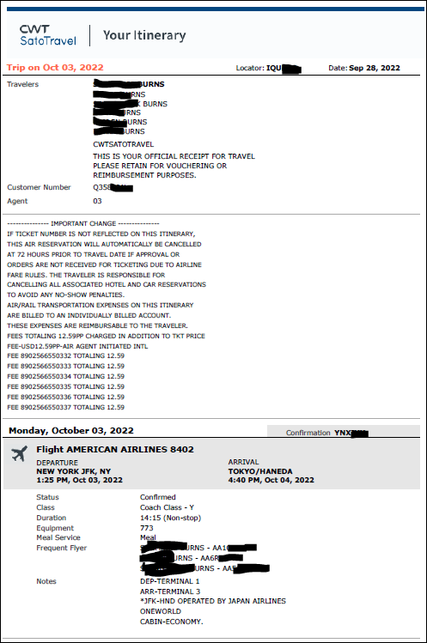
Itinerary VS Invoice
This is a SATO Flight itinerary. If you are booked flights and/or rental car you will receive an email with this attached. *We cannot retrieve your itinerary for you. *
Your voucher will automatically be returned to you if you do not have the invoice attached.
If you cannot find this in your email you will have to request the SATO INVOICE from their website.

Slide 19
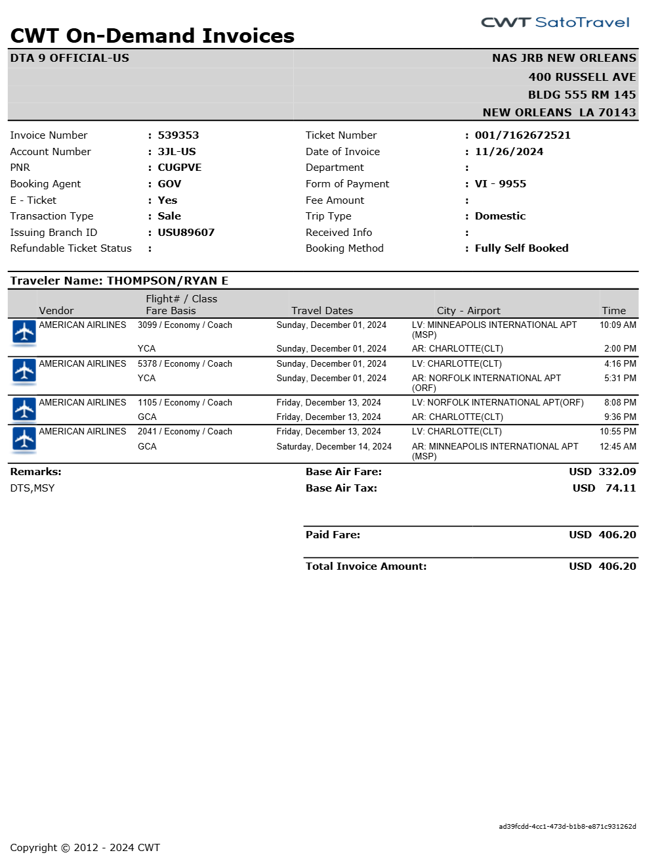
How to Request the CWT SATO Invoice Retrieval
EXAMPLE OF THE CWT SATO INVOICE
ONLY NEEDED IF YOU LOST THE ITINERARY!!!
*SHOWED ON PREVIOUS SLIDE*

Slide 20
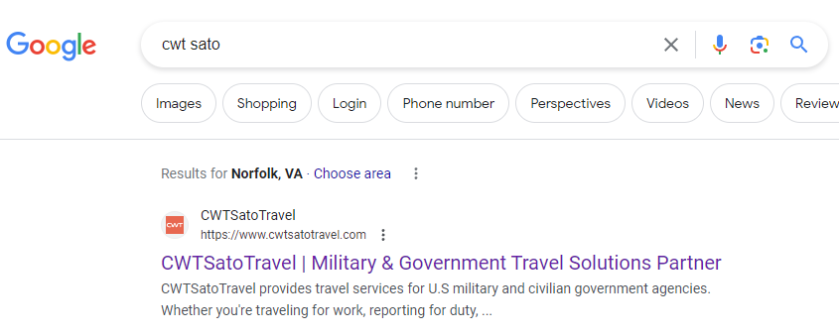
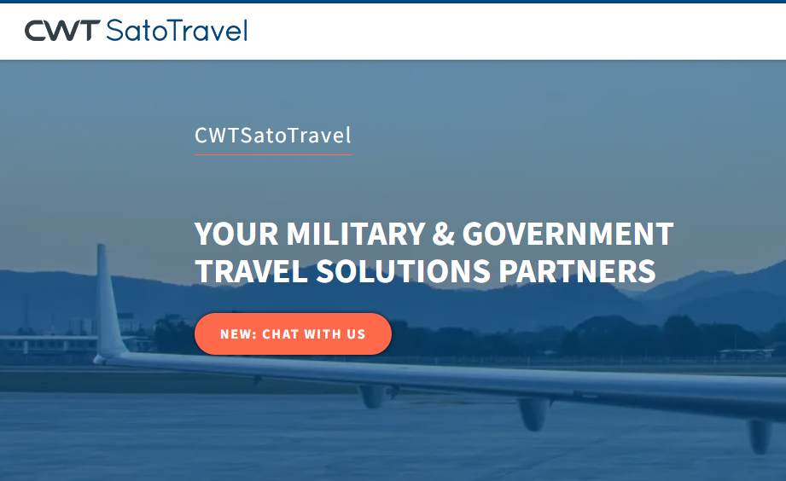
CWT SATO Invoice Retrieval
Step 1: Google “CWT SATO” in google search engine
Step 2: Click on CWT SATO result
Step 3: Select “New: CHAT WITH US” function

Slide 21
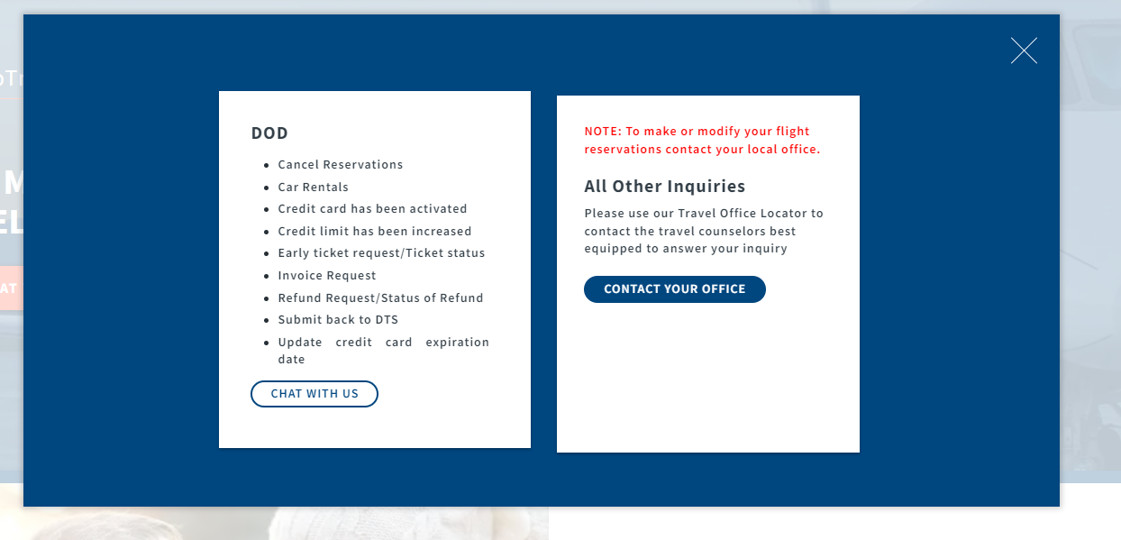
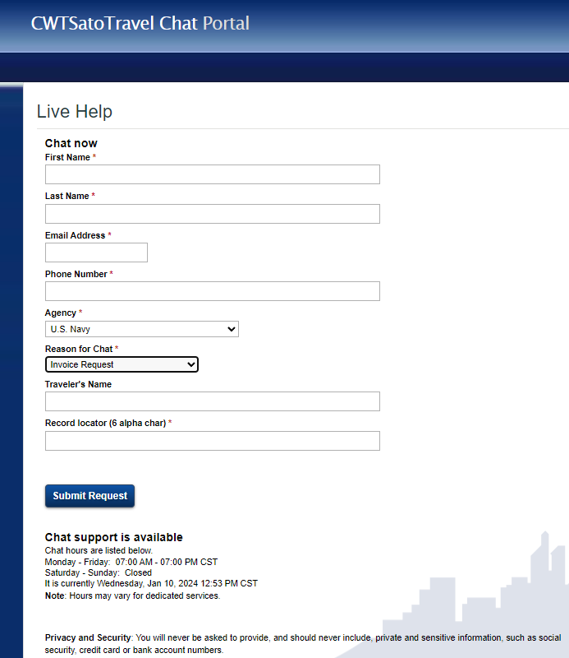
Step 4: Select “CHAT WITH US”
Step 5: Fill out requested information and enter chat
Do not use government email
Record locator found on itinerary

Slide 22
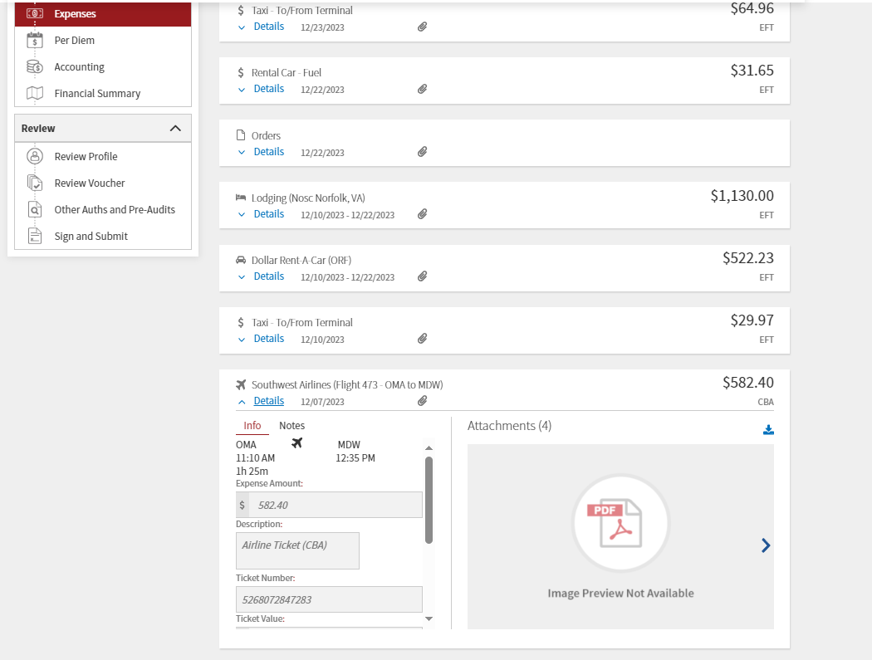
Uploading the CWT SATO Invoice
Upload SATO invoice into the pre generated flight expenses
If you had multiple flights on different airlines, please retrieve each invoice from your specific record locator
If the prices do not match do not adjust them! A civilian will balance the CBA account.
Upload here

Slide 23
HOW TO ACCOUNT FOR
TRAVEL BY POV

Slide 24
QUICK INFO ABOUT POV TRAVEL
What do I do if I want to drive to my orders?
Step 1: Email cnrfc_n14_travel@us.navy.mil informing us of this decision so we know not to book you flights/rental car.
Step 2: Calculate the route from your HOR to TDY to get the total milage of one-way travel.
Step 3: If under 400miles one way, you only need to properly account for the milage. If OVER 400miles one way, you will fill out a CTW form and attach this in your voucher along with the milage.
**CTW FORM AND HOW TO GUIDE ON SSO TOOLKIT**
You will only receive one travel day on your orders before your report date. If POV will take more than one day take this into account and always report to orders on time.
***When utilizing POV as mode of travel, you will only be reimbursed the mileage from your HOR to TDY and then back to HOR.
  You do NOT receive reimbursement for gas
  You do NOT receive reimbursement for TOLLS***

Slide 25
How to Upload in Voucher
All documents will be attached in the “EXPENSES” tab.
Click on the “EXPENSES” tab (on the left side.)
Click here to create a new expense item.
Expenses are added in this tab

Slide 26
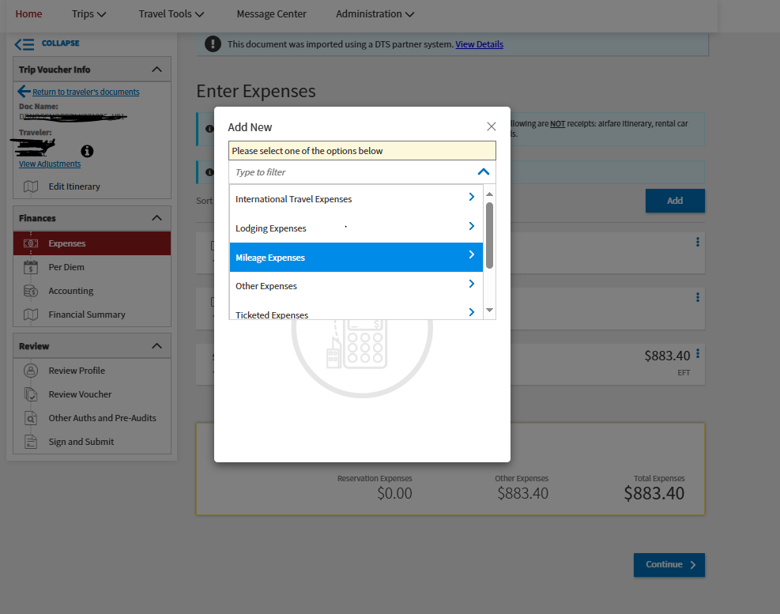
HOW TO ACCOUNT FOR POV MILEAGE
Select
“Mileage Expenses”

Slide 27
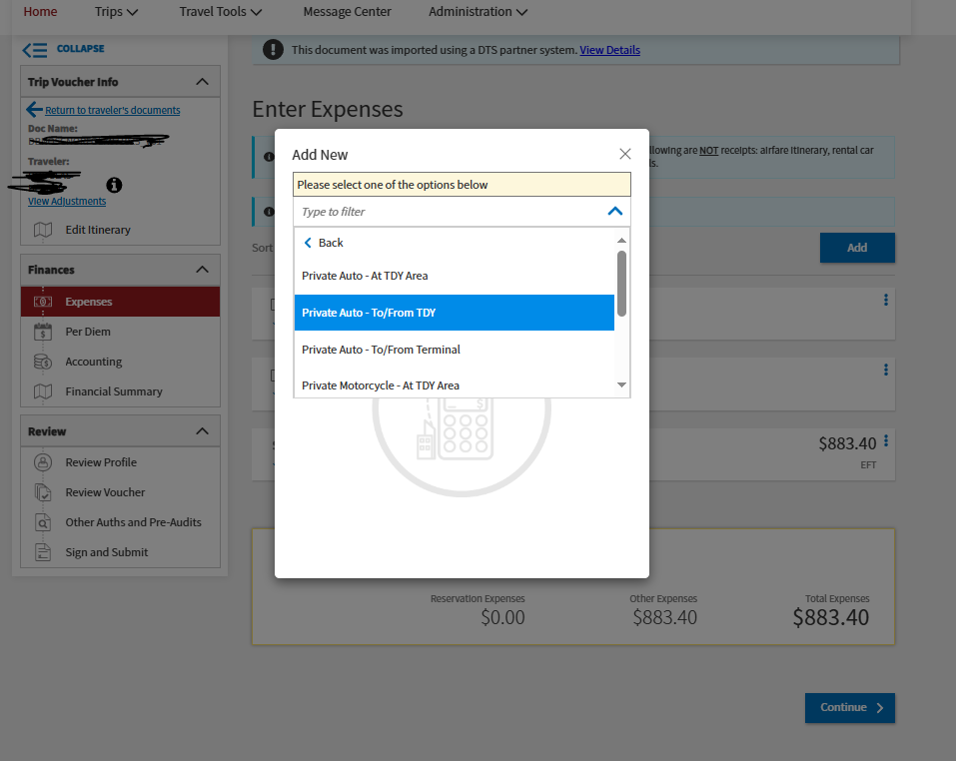
HOW TO ACCOUNT FOR POV MILEAGE
Select
“Private Auto – TO/FROM TDY”

Slide 28
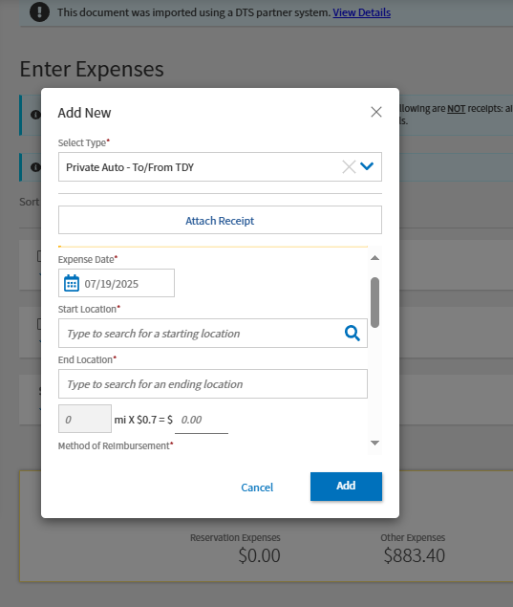
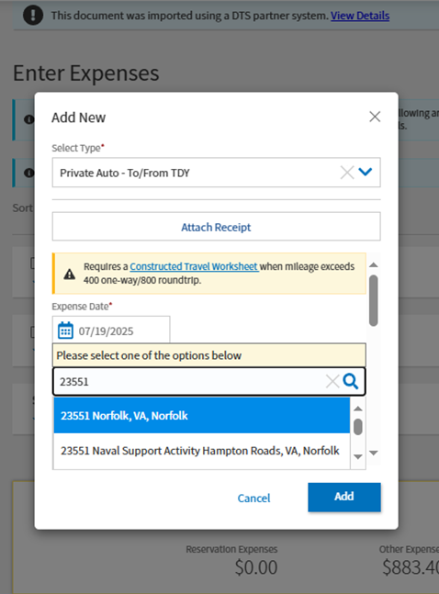
HOW TO ACCOUNT FOR POV MILEAGE
When you go to type in the locations, you should type in the zip code and give it a second to load and then a drop-down list of locations will pop up and you will then have to click one of those.
The system will then automatically calculate the mileage and mileage cost.

Slide 29
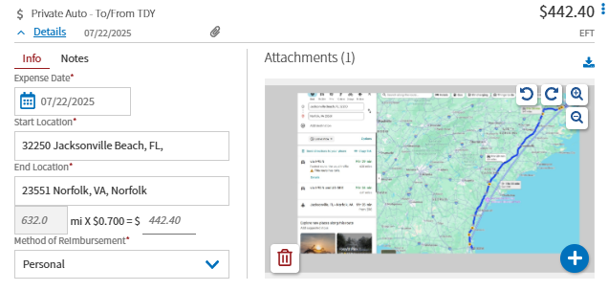
HOW TO ACCOUNT FOR POV MILEAGE
As a “receipt,” you will attach a screenshot of the route and mileage from a mapping software.

Slide 30
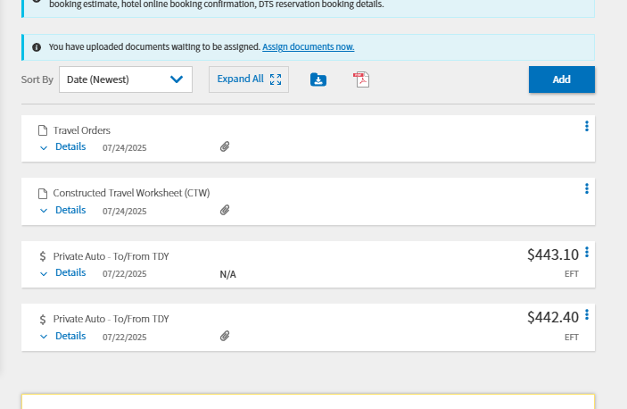
**CTW FORM AND HOW TO GUIDE ON SSO TOOLKIT**
If over 400miles one way, you will then be required to fill out a CTW FORM. This allows you to be reimbursed for the additional mileage over 400miles.
WHAT YOUR VOUCHER SHOULD SHOW
Travel >400 Miles CTW FORM
Separate mileage expenses for mileage from HOR to TDY and then for TDY to HOR.
Mileage one-way
Mileage one-way

Slide 31
HOW TO ACCOUNT FOR
LODGING

Slide 32
QUICK INFO ABOUT LODGING
When do you have to stay at the navy lodge?
  IF YOUR ORDERS STATE, “GOVERNMENT LODGING AVAILABLE AND DIRECTED” YOU ARE REQUIRED TO BOOK LODGING AT THE NEARBY NAVY LODGE.
  If there is no vacancy at the Navy Lodge, then you will obtain a CNA (Certificate of Non-Availability) from the hotel. Once you have this you are authorized to stay at a hotel off-base and this document must be attached to your voucher.
How do I claim off-base lodging? (CONUS SPECIFIC)
  You will request a DAILY ITEMIZED Lodging receipt from the hotel. This will show the separate costs of the daily rate of the room and any additional taxes and fees.
  The daily rate of the room will be what is reflected in your lodging per diem amount. (EXAMPLE SHOWN IN NEXT SLIDES)
  The TAXES AND FEES will be compiled as a separate expense labeled as Lodging Taxes in the voucher. (EXAMPLE SHOWN IN NEXT SLIDES)
  ***If you were traveling OCONUS then you DO NOT separate the taxes and fees from daily rate. You will leave it combined and put the total as the lodging per diem ***

Slide 33
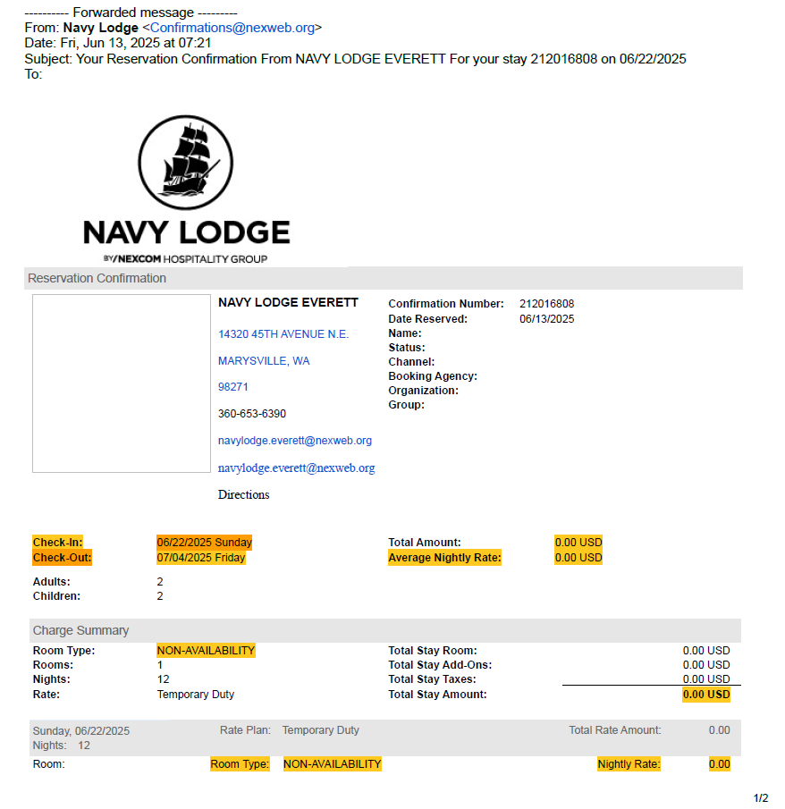
EXAMPLE OFFBASE LODGING: LT JOE SHMOE
LT JOE SHMOE was directed to get lodging at the local base. He called and they had no rooms for him at the time he was requesting. He asked them to email a CNA stating there was no rooms.
(Example on right)
EXAMPLE OF A CNA

Slide 34
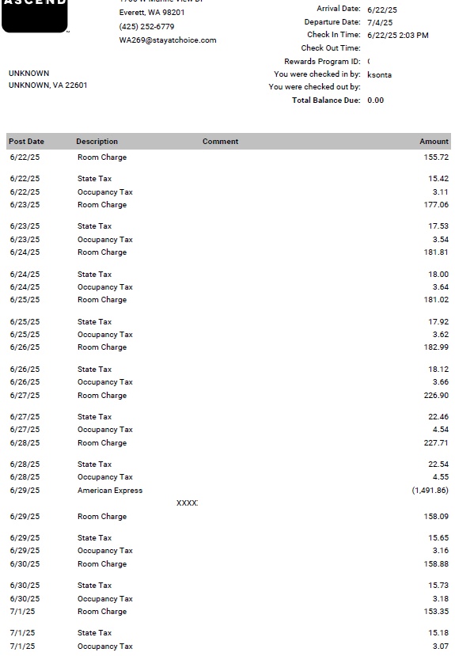
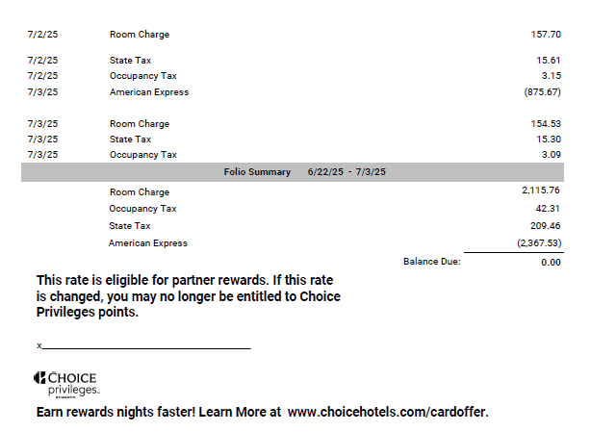
EXAMPLE OFF BASE LODGING RECEIPT
(Example Off-base Lodging Receipt)
LT JOE SHMOE then got a reservation at a nearby hotel off base. When he checked out of the hotel, he made sure to request an itemized daily lodging receipt that showed separate charges.

Slide 35
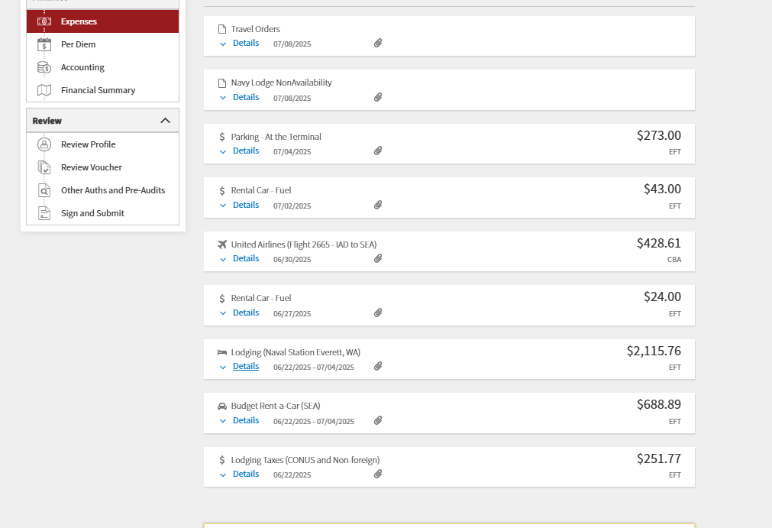
LT JOE SHMOE attached all documents into his voucher as shown.
EXAMPLE OFF BASE LODGING RECEIPT
HOTEL CNA
LT JOE SMOE added the taxes from his hotel lodging receipt and inputted it as one expense.
DAILY Lodging Rate
Separate Lodging Taxes

Slide 36
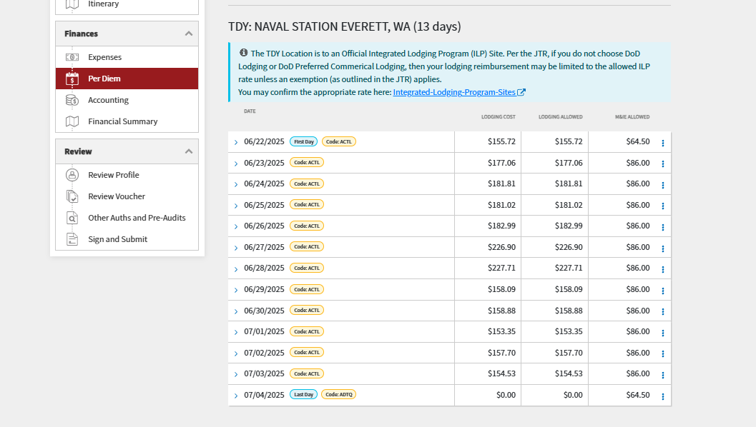
LT JOE SHMOE adjusted his lodging per diem to reflect the daily rate for each day of lodging as shown in his receipt.
EXAMPLE OFF BASE LODGING RECEIPT

Slide 37
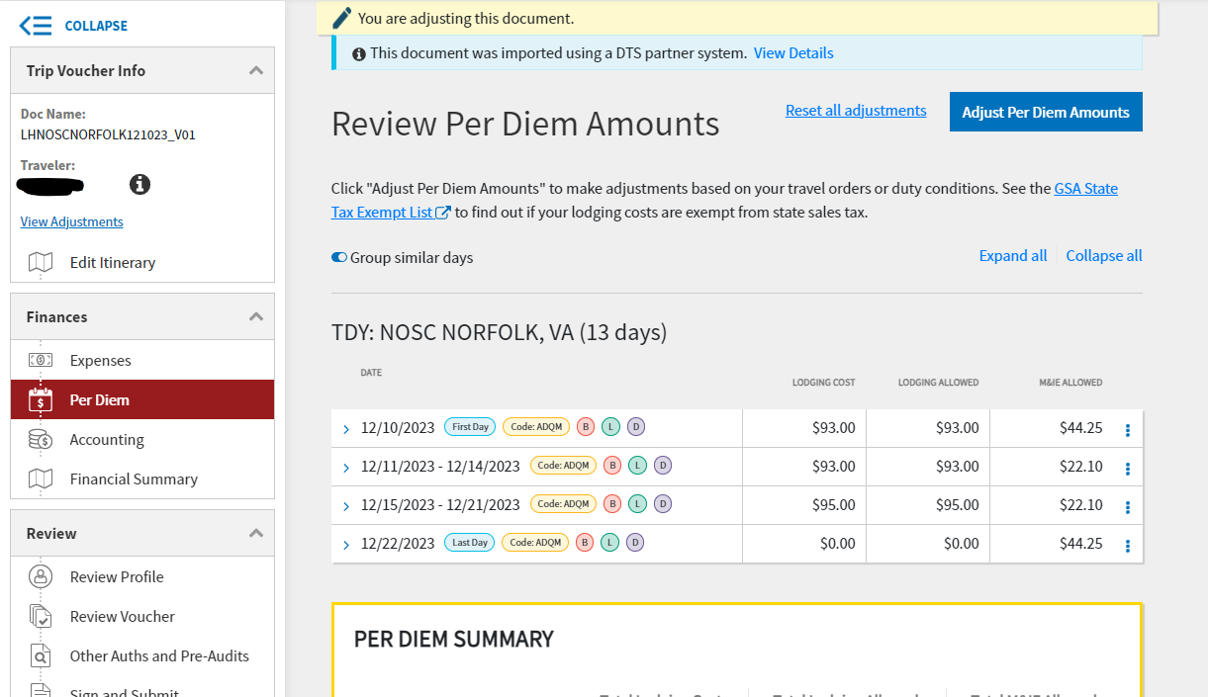
How to ADJUST PERDIEM RATE
STEP 1: Go to per diem tab
STEP 2: Click “Adjust PER Diem Amounts”

Slide 38
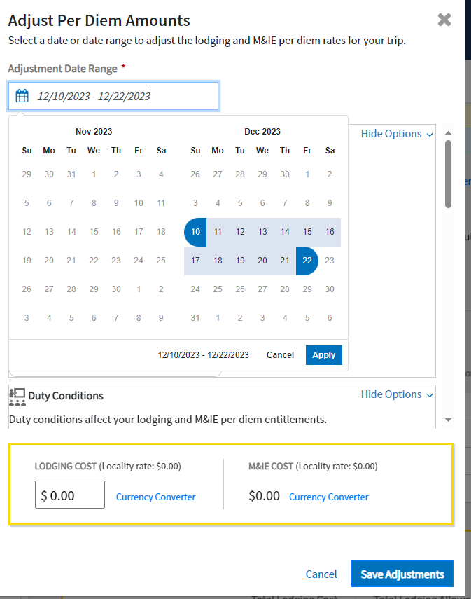
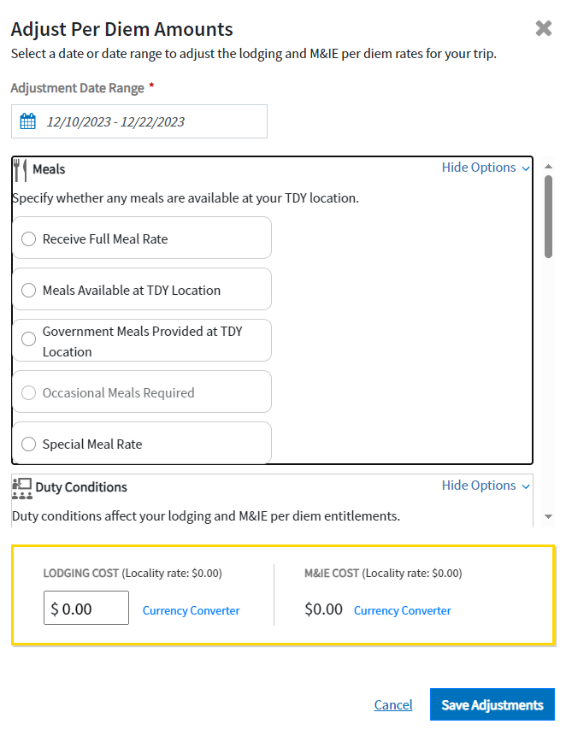
Adjusting Per Diem
Select the days that need to be adjusted
Select meal rate specified in orders. This will change this rate.
Adjust lodging cost Here.

Slide 39
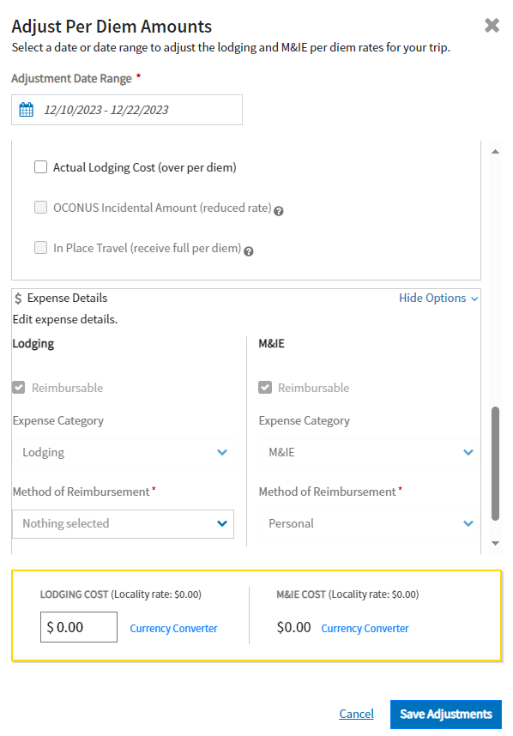
Adjusting Per Diem
If you check this box have a valid answer in the “Other Auths and Pre-Audits”. If NGIS was used and over per diem just write “NGIS used.”
“Method of Reimbursement” will be “Personal”

Slide 40
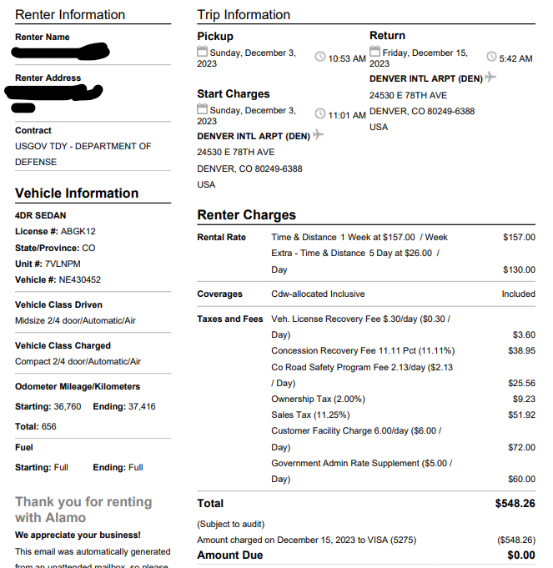
Rental Car Receipt
RECEIPT MUST SHOW “FINAL” OR “TOTAL” COST. CANNOT SAY ESTIMATED.
GARS should be listed
Must be final total (as shown)…not “estimated”

Slide 41
Closing Remarks
If you think you are authorized reimbursement for an expense add it to your voucher!
Utilize the JTR and other internet resources
Read your orders to fully understand what you are entitled to.
If any questions arise, please reach out to our travel distro at cnrfc_n14_travel@us.navy.mil

